Slide 1
IRI Voracity on OCI & Autonomous: Simplifying Data Management & Our Business
David Friedland, SVP IRI, The CoSort Company
Oracle Global Leaders Event, Miami Jan 22-23rd 2020
Oracle Global Leaders Program

Slide 2
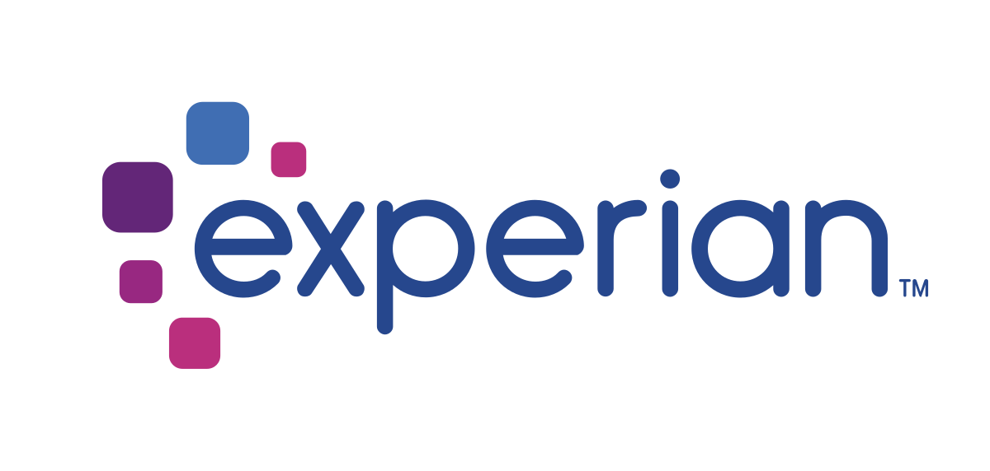
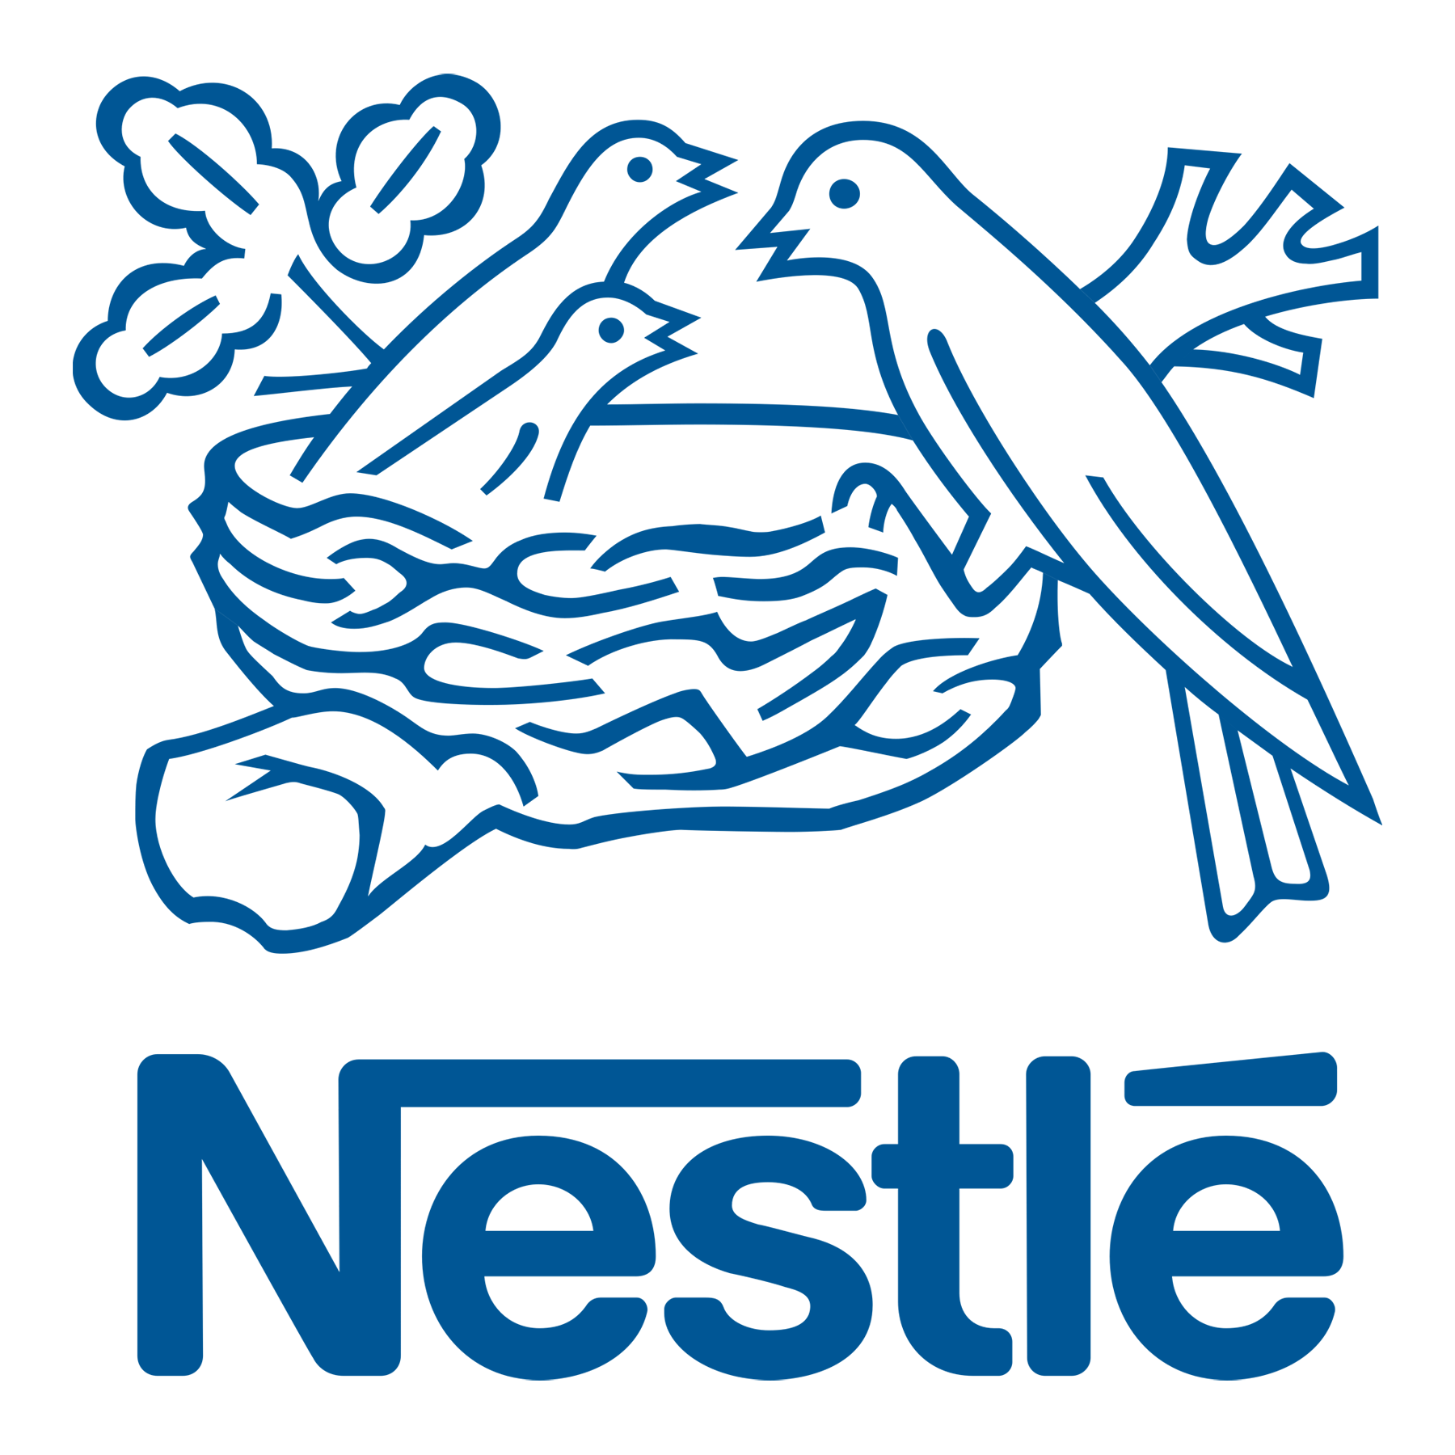
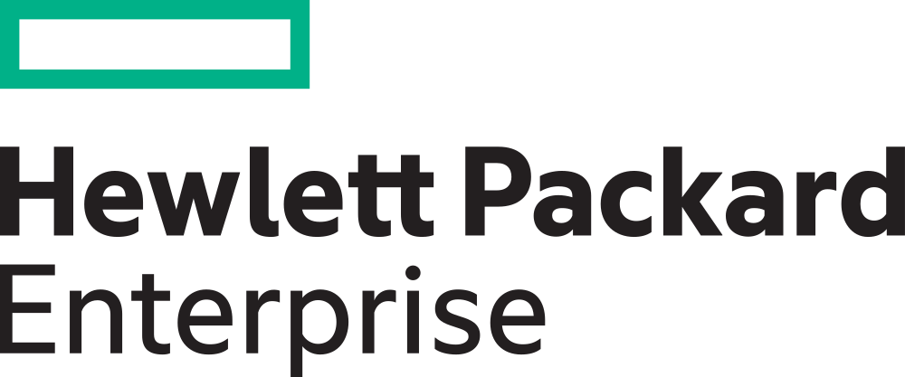
Selected Customers
About IRI, The CoSort Company
Melbourne, FL data management ISV specializing in fast, big data manipulation & security, w/wo Hadoop.
Silver level Oracle Partner. Global users & channels.
Renown since 1978 for JCL sort & data migration, DB/DW/BI acceleration, PII masking & test data.
Notes:
I’m the VP of Business Development at Innovative Routines International (IRI), Inc., better known as IRI and most well known for a 42-year data transformation utility called CoSort. And no, we’re not the retail data brokering IRI in Chicago, but the privately held fast data management and data-centric security ISV up the road in Melbourne, Florida.
Anyway, I’m also the the company’s technology evangelist for our relatively new data management platform called Voracity, which is a powerful place to do ETL, data cleansing, data masking, migrate data and databases, subset and synthesize test data, and wrangle or analyze data …. on premise or in the cloud.
You can see a handful of our customers here, and more information on the tool in the appendix at the end of this slide deck, from our web site - iri.com - or on the USB cards I have.

Slide 3
IRI Partnership with Oracle
Our customers are asking for PaaS-native solution options.
No one wants to be in the business of managing data centers.
Increasing demand from cloud-minded customers who need high security, horizontal scalability, and ease of use.
Today IRI products and the Voracity platform are only available on-premise or in customer-managed Cloud VM’s
We’re partnering to create Voracity-based PaaS solutions in Oracle Cloud Infrastructure + Autonomous Linux + Autonomous Database
Notes:
So what are we doing with Oracle lately? We’re heading headlong into its cloud.
We’ve been selling our software on premise for more than 40 years. During that time I’ve had to keep up with pricing tools like CoSort on every Unix hardware model and Windows RAM configuration ever offered, while our engineers have spent tons of unrecompensed time in tweaking tuning, licensing, and configuration advice for our customers computers and databases. I’d like to move on, just as our customers would.
Oracle Cloud Infrastructure strikes us as more than just a way forward … it should give us a great play in the competitive, burgeoning market for platform as a service solutions.

Slide 4
Outcomes for IRI & Oracle Customers
Reduce costs while reducing data risk
Move from administration to innovation
Increase productivity to drive business growth
New ways to deliver apps, services and experiences
Scale on demand. Pay for what you use.
Notes:
We’re building native Platform as a Service options in Oracle so that Voracity customers can:
Reduce operating costs while also reducing cloud data security risks
Scale their operations to suit their actual needs; and,
Improve productivity and drive business growth by shifting the energy and expense of on-premise infrastructure and maintenance info getting more performance and better information. In other words, by moving away from the work of administration toward the business of innovation.

Slide 5
IT Needs (Unburdening)
70%
39%
95%
of time spent on maintenance; IT is unable to keep up
of DBAs handle 50 or more databases
of DBAs are still creating and updating databases manually
Implement emerging technologies to help the business innovate
Ensure performance SLAs, Security, Regulatory Compliance & Availability
Safeguard data so it can be trusted and accessed to get insight
Notes:
So which customers in particular care about these outcomes? It’s your data and database administrators, and it’s your data professionals or business analysts mostly. But you may also glean later, it’s those concerned with data governance, too.
From the data administration and IT perspective, these folks are spending more time keeping the lights on than innovating today. The Oracle Cloud helps them avoid all that work setting up RACs, and all the database and network administration stuff they do now … and instead start trying out things immediately.

Slide 6
LOB Needs (Analytics)
75%
375%
4x
70%
of time spent in analytics by 2020 compared to 25% in 2015
increase in analytics spending by marketers since 2017
faster quota attainment by sales teams that use analytics
in the midst of major data projects for decision making
Finance
Marketing
Sales
HR
Cut costs, optimize spend, track key business metrics with rapid insights
Use improved customer insights and track demand gen
Ensure a constant 360 degree view of customer, bookings, pipeline
Improve employee productivity, performance. Track budget and recruiting
Notes:
Meanwhile, business teams are putting increasing pressure on those same IT people to get help generating the insights that can drive profitability and growth.
Specifically, Accenture predicts the best Finance people will spend up to 75% of their time on analytics to figure out how further cut costs and allocate funds to promising opportunities. They need data wrangled and delivered as fast as possible.
Marketing is looking to improve customer acquisition and retention by figuring out the best ways to accelerate conversions through the right messaging and spends. Their investment in analytics is way up, too.
Sales teams using analytics are 4 times more productive than those who don’t, because they can figure out which prospects and customers to approach with what offering quickly, and understand the content and offers to use at each stage of the sales cycle.
HR is also looking for new insights to help with hiring, to predict which candidates will or won’t succeed based on historical patterns, and to understand which employees should take which training courses or get some kind of intervention to head off a problem.
So a lot of analytics should move to the cloud now so data professionals get better results.

Slide 7
Voracity iPaaS / Data Wrangling in Oracle Cloud - Solution Architecture
Personal or external datasets
IRI iPaaS Data Integration (1)
Autonomous Database
(2)
Oracle Analytics Cloud
(3)
Business Leaders
Profitability
Variance
Procurement
Cashflow
Cost management
Financial Functional
Data
Analysts
Enterprise applications
Data
Scientists
Extract data from your systems and load to ADW with IRI Cloud
Makes data available for analytics
Self-service analytics with ML/AI
AutoMaster
Defi
RDN
Customers
Notes:
To that end, in its upcoming OCI capacity, IRI Voracity will be an Integration Platform as a Service. By default, Voracity uses our CoSort engine for fast ETL and data wrangling.
The integrated, cleansed, and pre-sorted data will fast load into the Autonomous Oracle Database, and from there, allow business users with access to those tables the ability to analyze and visualize their data in the Oracle Analytics Cloud (OAC). So public and private data in, good information out. Fast.
----------------------------------------------------------------------------------------------------------------------------------------------------------------------------------
FYR: https://www.oracle.com/middleware/technologies/oracle-analytics-cloud.html & https://apex.oracle.com/en/platform/powered-by-oracle/
AND, The Oracle Autonomous Database is:
Self-Driving – Lower Cost & Increased Productivity
Eliminates human labor to provision, secure, monitor, backup, recover, troubleshoot, and tune the database
Automatically upgrades and patches itself while running. Testing automation ensures changes are safe.
Elastically grows and shrinks compute or storage without downtime. Pay only for what you use.
Self-Securing – Lower Risk
Protection from external attacks and from malicious internal users
Automatically applies security updates with no downtime.
Automatic encryption of all data.
Self-Repairing – Higher Availability
Automation eliminates administrator errors
SLA Guarantees 99.995% availability. Less than 30 minutes downtime per year including planned maintenance

Slide 8
Business Benefits - IRI Voracity on Oracle Cloud
Reduce TCO up to 50% moving to cloud
Deploy IRI technology in hours – not weeks
Superior performance backed by SLAs
No single point of failure
OCI credits provide a flexible consumption model
2-10x faster reporting speeds
cloud.oracle.com/en_US/iaas/customers
Notes:
By combining the Oracle cloud database and Voracity as a service offering in the same environment, these customers can lift and shift these analytic workflows -- and all the preparation for them -- into a much less expensive operating platform … both short and long-term.
Obviously in the short term, they can spin jobs up much faster by not having to procure, configure, and secure all the hardware, networking, and software components involved on-premise - because it’s already staged in the cloud ready to go.
Plus, everything Voracity offers by way of data discovery, integration, migration, governance, and analytics is built in, and so is everything they’d need do with Oracle and other apps. All these things are covered under OCI’s universal credit system, too.
In terms of reliability, OCI provides very competitive SLAs for availability, performance, and manageability. Multiple data protection protocols are also part of the infrastructure, as is disaster recovery to assure business continuity … not to mention the autonomous nature of the operating system and database which removes failure points and security holes.
But I think the bottom line again is the improvement in decision speed that results from the combination of fast data preparation in IRI Voracity and the power of the Oracle cloud database and analytics systems in OCI.

Slide 9
Universal Credits = Flexible Consumption
Unlimited Access to all Oracle Cloud Services
Consumption Choices
Pay As You Go (PAYG)
Monthly Flex
One simple contract, simplifies the buying experience
Universal access to all current and future Oracle Cloud services
Lower prices based on monthly dollar commitment
Flexibility to upgrade, expand or move services across datacenters
No upfront commitment
Pay only for what you use
Pay in arrears based on usage
1 year minimum term
Agreed to monthly spend
List price
Best when usage is uncertain
Elastic payments based on usage
Observed 33%-60% savings vs PAYG
Discounts based on size of deal and term of deal
Lowest spending without sacrificing flexibility
Notes:
Just for a bit more detail on some of those points …
Oracle’s Universal Credits make PaaS solutions on OCI easier to metric, and unify from a cost standpoint worldwide. When you look at all the ways you can license Voracity or its component products on premise today, it can be complicated as I mentioned earlier. I’m looking forward to a simpler pricing and revenue accounting in this cloud model … for us and our resellers.

Slide 10
End-to-end Cloud Infrastructure SLAs
 |  | AWS | Azure | GCP
Availability | Covered | Covered | Covered | Covered
Performance | Covered | No coverage | No coverage | No coverage
Manageability | Covered | No coverage | No coverage | No coverage
Notes:
On the SLAs, we think Oracle has set a new standard for them in the cloud.
Beyond just uptime SLAs, Oracle is guaranteeing cloud customers will get the bandwidth and data transfer speeds they need to perform their work effectively, and manage how their data moves around, plus how resources get scaled and listed.
These differentiators appeal to Voracity customers who expect high speed in volume, low system maintenance, and that the right people can always log-in and do their thing (while everyone else gets blocked out).

Slide 11
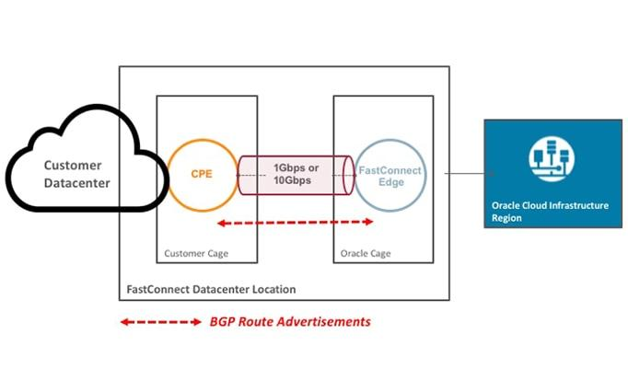
Oracle Cloud Infrastructure - FastConnect
Easy, Elastic, and Economical way to create a dedicated and private connection which is consistently fast
Get a reliable and ‘big data’ network experience compared to internet-based connections
No outbound data fees when paired with FastConnect
Notes:
Another thing I really like on the performance point by the way is the FastConnect feature in OCI … to help users make sure they’re always getting in and getting the speed they need.
This goes beyond your ISP to make sure that when you’re in the OCI environment, 1) the bandwidth inside it is all yours, 2) you’re not getting nickeled and dimed on the volume of data you’re moving - which again in the Voracity world (be it ETL, migration, cleansing, masking or test data synthesis), is a LOT.

Slide 12
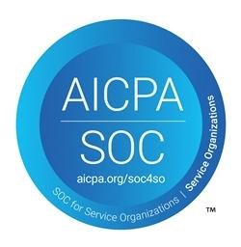
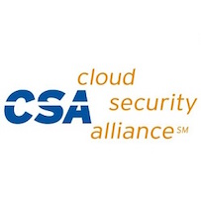
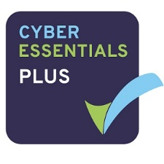
OCI Compliance: Current Audit Programs
Global
Government
Industry
Regional
SOC 1 : SOC 2 : SOC 3
27001 : 27017 : 27018
Self-Assessment
US Privacy Shield
DoD DISA SRG IL2
Moderate – Agency ATO
VPAT – Section 508
G-Cloud 11 - UK
Model Clauses - EU
Level 1
HIPAA
PCI DSS
FISC - Japan
IG Toolkit - UK
C5
GDPR - EU
BSI C5 - Germany
TISAX - Germany
PIPEDA - Canada
Cyber Essentials Plus - UK
My Number - Japan
Cloud Security Principles - UK
Notes:
Last but not least, Oracle’s information security compliance programs span multiple milieu you see here. These certifications combine with the data masking and re-ID risk scoring technology in Voracity. So together we can pitch confidence in the security of customer data at what should be every start and endpoint of this infrastructure. And that should continue to be true as our compliance programs expand in scope and reach.

Slide 13
More IRI Voracity PaaS Plans for OCI
IRI iPaaS Data Integration (New or Legacy ETL)
IRI DMaaS Data Masking & Risk Scoring
IRI DQaaS Data Quality & Unification
IRI TDaaS Test Data Synthesis
IRI BDaaS Big Data Package/Provision
IRI MaaS Data/DB Migration
Extracting data from your systems and loading to ADW via Voracity ETL in OCI Gen 2 Cloud.
Connecting, classifying, searching, de-identifying and auditing PII in RDB and NoSQL DBs, images, files & faces.
Validating, filtering, cleansing, enriching, standardizing and reconciling data and master data.
Using DDL and file metadata to create structurally and referentially correct test data from scratch.
Integrating, cleansing, and masking with or without Hadoop to wrangle data for analytics.
Extracting file or DB data from legacy systems and converting it for use in new DBs or apps.
Notes:
So thanks to Oracle handling the credits for us, and lowering the cost, complexity and risk around infrastructure for our customers, we’ve got bigger plans.
Voracity can not only be a data integration platform as a service, but also a data masking platform as a service for sensitive data, a data quality platform for dirty data, a test data platform for DevOps and Oracle prototypes, a big data processing platform when Hadoop is in play, and a data migration platform for moving schema and files from old to new.
OK, here’s the bottom line:
This year, we are partnering with Oracle to platform these options -- or everything at once -- for customers who want fast, reliable, and easily scalable cloud services that they can also trust and afford. IRI feels that those are compelling, competitive, easy-to-communicate, and cost-out messages to send. And we believe that Voracity in OCI will give us more time for development, let our partners make more money on services, and shift our customers away from on-premise maintenance and money hassles and into more innovation with us.

Slide 14
Thank you.
Contact Me / Learn More:
David Friedland davidf@iri.com +1.800.333.SORT | iri.com/voracity iri.com/solutions iri.com/blog linkedin.com/company/iri-the-cosort-company/ twitter.com/IRI_CoSort
Notes:
Thanks for your time and attention here. Please find me afterwards if you want to get into this or learn more about what we’re doing. I also have this presentation and Voracity-related collateral on USB cards.

Slide 15
APPENDIX
IRI Solution Software and OCI Configurations
for
Oracle Data Administrators and Data Professionals
Notes:
Additional information on Innovative Routines International (IRI), IRI Voracity, and OCI

Slide 16
More on IRI and Voracity
Named a ‘top big data provider’ by CIO Review & Insights Success
Dubbed a Production Analytic Platform by Dr. Barry Devlin
Covered by the BBBT
Listed in 100 Most Important Companies in Data AND Trendsetting Products by DBTA
Followed by Gartner & IDC in data integration and masking markets
Featured in M&M global market forecast reports on: Data Classification, Data Governance, and Big Data as a Service
IRI USPs:
Best ETL industry price-performance ratio
Multi-source PII classify/search/de-ID functionality
Included DQ, BI, CDC, IoT, and test data capabilities
Seamless/no-code Hadoop executions
Supports all RDBs, LUW flavors + erwin, Splunk, KNIME
Notes:
For more information see https://www.iri.com/company/about-iri-the-cosort-company/recognition and https://www.iri.com/customers

Slide 17
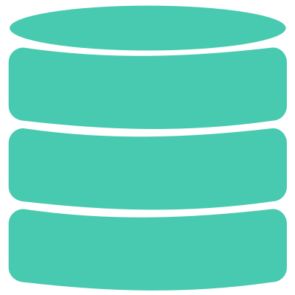
Fit-for-purpose IRI software products -- or their wizards in Voracity, backed by IRI services -- propel, protect, and prototype Oracle DB, ODI & DV ops. These will be available as ad hoc or bundled PaaS options in OCI in 2020.
Fast Unload & Load
Fast Query & Reorg
Migrate & Replicate
TEST DATA
GDPR, CCPA
HIPAA, FERPA
PCI DSS
Transform (ETL) & Cleanse, Wrangle & Report
PII Search & Mask
Synthesize & Subset
Notes:
Oracle users have licensed those IRI software products for years to perform, speed, or combine one or more of these critical data processing and protection functions at scale for on-premise Oracle DBs. For details, see https://www.iri.com/solutions/database-acceleration/oracle and note we’re running all this on the Autonomous Oracle Database (v18) in OCI now.

Slide 18
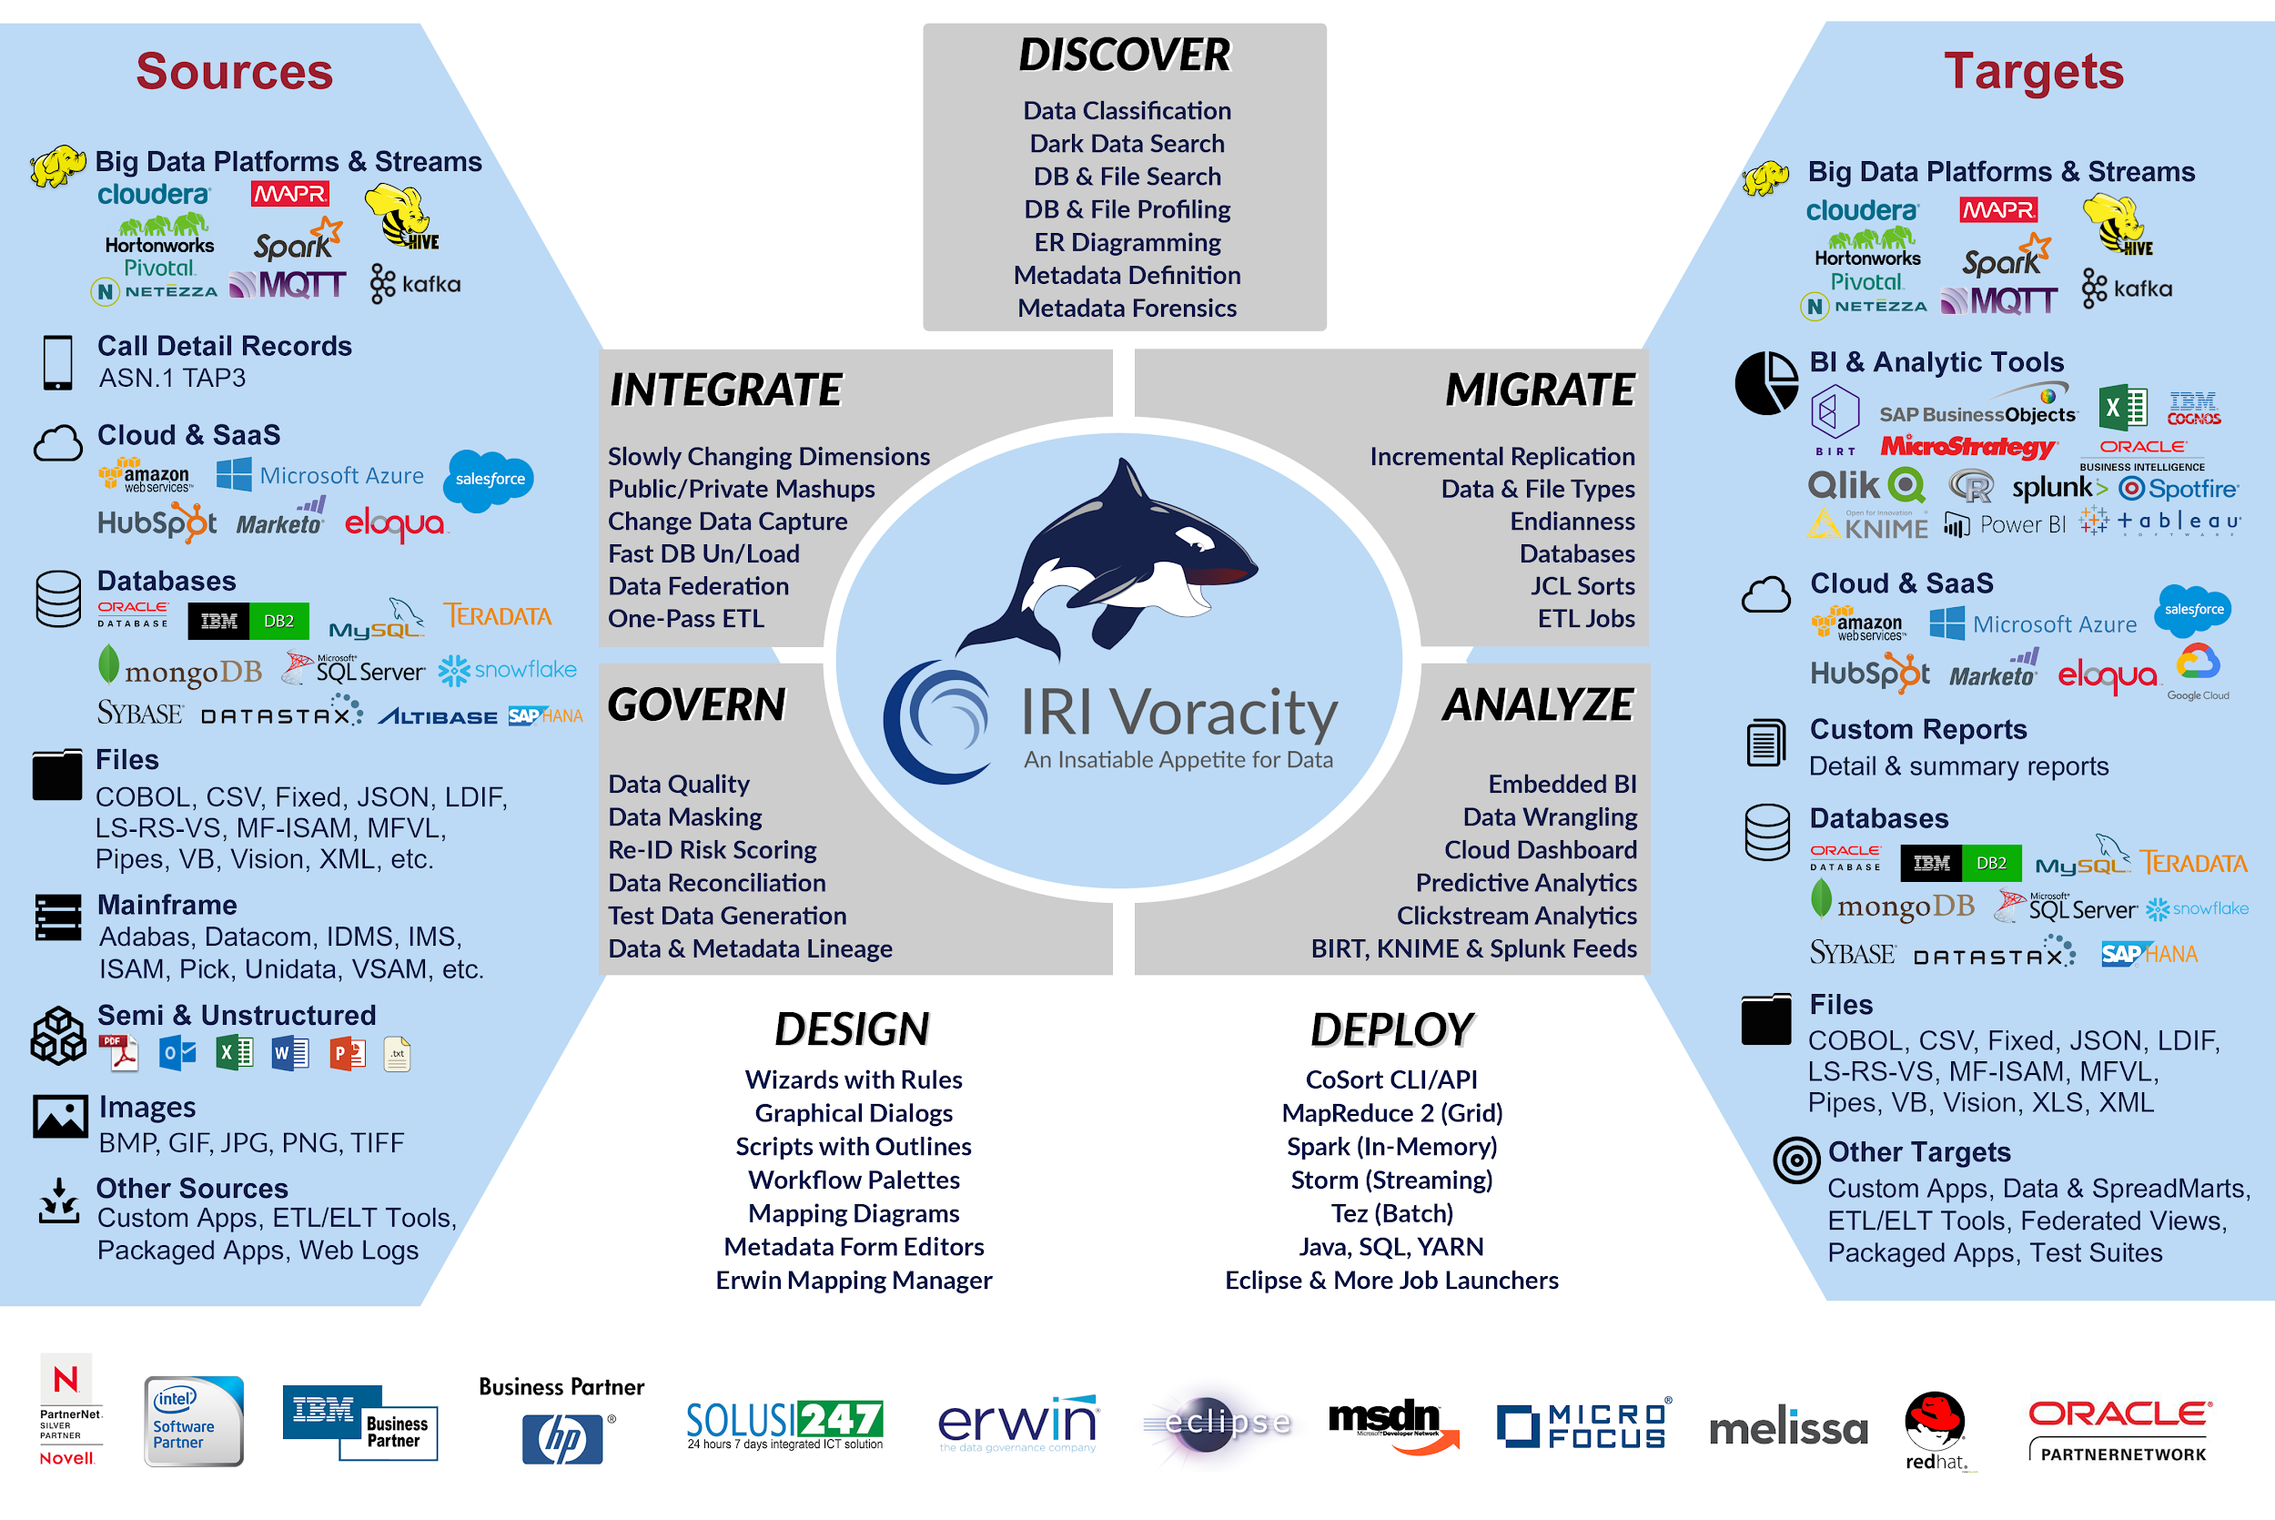
Notes:
IRI Voracity is a ‘total data management software platform’ that runs on-premise or in the cloud to curate the data life cycle. Voracity uniquely speeds and combines the major, mission-critical activities of data discovery, integration, migration, governance and analytics. Voracity is powered by IRI CoSort or seamlessly interchangeable Hadoop engines, and built on Eclipse.

Slide 19
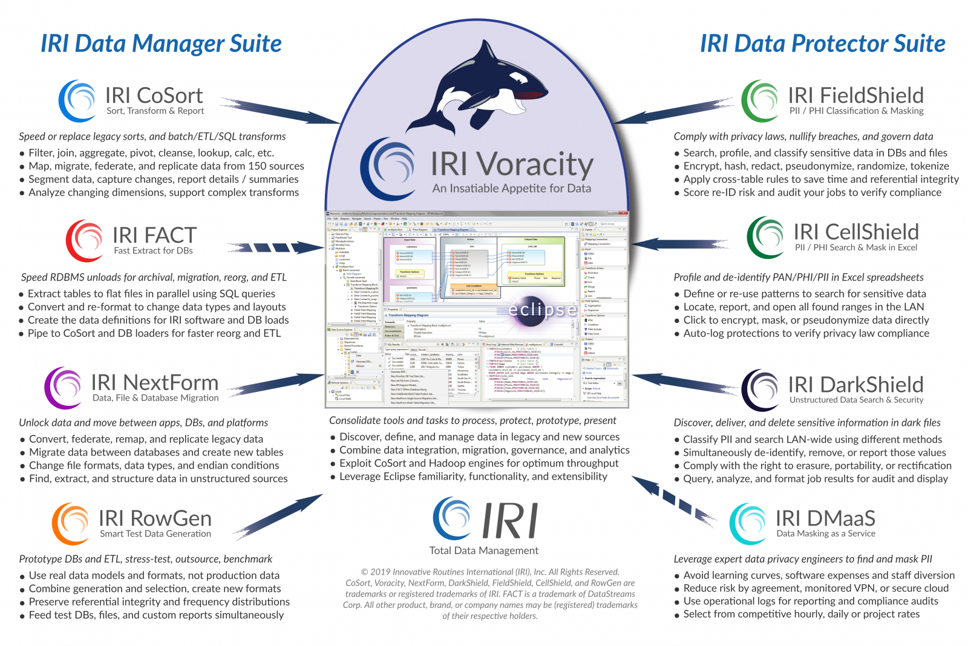
Notes:
All Data Manager and Data Protector Suite products are supported in Voracity and front-ended in the same Eclipse pane of glass, IRI Workbench.

Slide 20
Listener
User
Virtual Cloud
Network
User
Load Balancer 100MB
Load Balancer Failover 100MB
Internet Gateway
OCI Architecture
Public Regional Subnet
AD1
AD2
Backend Set
Virtual Machine
AD3
Virtual Machine
Private Regional Subnet
VPN
Object Storage
Block Storage 30GB
Block Storage 30GB
Large Shape Std 2.24 – 24 OCPU, 320 GB Mem
Medium Shape Std 2.8 – 8 OCPU, 120 GB Mem Small Shape Std 1.2 – 2 OCPU, 14 GB Mem
Service Gateway
Notes:
Oracle Cloud Infrastructure 2020.

Slide 21
OCI Networking Flexibility and Control
Customer data center
Oracle cloud region
Web Tier
VIRTUAL CLOUD NETWORK
Availability domain-1
Virtual Machines
Subnet-A
App Tier
Availability domain-2
Virtual Machines
Subnet-B
Database Tier
Availability domain-3
Database Storage
Subnet-C
Load Balancer
VPN
Provisioned bandwidth Load Balancing
Customer
Datacenter
Backbone
DNS
FastConnect
Other Oracle cloud regions
DNS
End customers
Notes:
VPN or FastConnect options.
Complete set of network services you need in the cloud with the same network flexibility you have today on-prem.
Comprehensive connectivity options –
Your datacenters: FasConnect, IPsec VPN
Connecting to other datacenters – Via private and secure backbone
Connecting to other clouds – Azure
Connecting to the internet – DNS, WAF, IG

